Slide 1

DTSC 5502 – Principles and Techniques for Data Science
Automated Vehicle Insurance Fraud Detection with Supervised Machine Learning
Project Presentation
Group – 2
Sai Kumar Akkamshetty
Uma Abhishek Polakonda
Aakash Reddy Varala
Hanumantha Reddy Varikuti

Slide 2

Roles and Responsibilities
Sai Kumar Akkamshetty – SaiKumarAkkamshetty@my.unt.edu
Role: Code Development, Dataset Selection, Data Processing and Preparation
Uma Abhishek Polikanda – UmaAbhishekPolakonda@my.unt.edu
Role: Code Development, Feature Extraction, Model Prediction and Evaluation
Aakash Reddy Varala – AakashReddyVarala@my.unt.edu
Role: Code Development, Model Prediction and Evaluation, Data Analysis
Hanumantha Reddy Varikuti – HanumanthaReddyVarikuti@my.unt.edu
Role: Project Documentation, Dataset Selection, References and Related Projects
WORKFLOW:
Our project collaboration has been fostered through regular in-person Wednesday meetings and additional online sessions via Microsoft Teams. We plan to enhance our code development and project documentation using Jupyter notebooks. The workflow is organized into specific phases, commencing with Data Pre-processing and Exploration, followed by Model Development and Training. Next, we transit into the Testing and Evaluation phase, succeeded by Performance Analysis. The concluding steps involve thorough Documentation and the generation of a comprehensive Final Report. This structured methodology ensures a systematic and efficient progression through each project stage.

Slide 3
Abstract
The main goal of our project is to build an automated fraud detection model that can identify fraudulent vehicle insurance claims. With the increasing complexity of insurance claims, it has become critical to detect fraudulent activities efficiently. Our model will explore previous auto insurance claims data, extracting similar features and patterns that point to potential fraud. By using advanced machine learning algorithms, we want to create a predictive model that can detect fake insurance claims in real time.
We will use a real-world dataset sourced from Kaggle, involving structured insurance claims data. Our project will use supervised Learning methods, with an initial focus on Random Forest, to classify claims as either genuine or fraudulent. This project will analyze insurance claims data to identify unusual patterns and mark possible fraud cases. By automating this project insurance companies can greatly reduce financial losses due to fraudulent claims, improve the overall efficiency in claim processing and help in maintaining the integrity and sustainability of the Auto Insurance firms.
This project not only helps to overcome the financial losses but also helps in maintaining the integrity and sustainability of the Vehicle Insurance firms.

Slide 4

Dataset Specification
The dataset (carclaims.csv) contains 33 features with 15,420 samples that are used to predict the target variable (fraud found). The data set contains 923 fraud detections/cases.
Features:
The features are utilized in training machine learning models that include month, week of month, day of week, make, accident area, day of week claimed, month claimed, week of month claimed, sex, marital status, age, fault, policy type, vehicle category, vehicle price, policy number, Reg number, deductible, driver rating, days: policy accident, days: policy claim, past number of claims, age of vehicle, age of policy holder, police report file, witness present, age and time, number of supplements, address change claims, number of cars, year, base policy, fraud(Y/N).

Slide 5
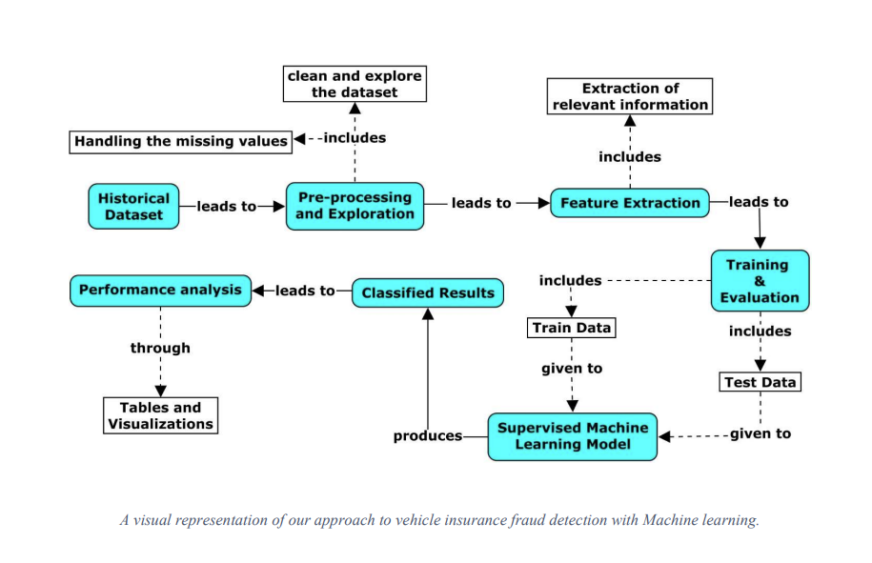
Project Design

Slide 6
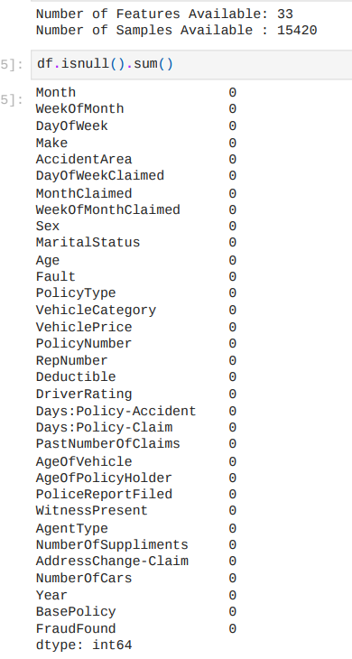
Data Preprocessing
To identify the most important features from the dataset that aid in fraud detection, we carried out null value identification and removal, duplicate value and missing value removal, and so on.
We have no duplicate values or missing entries in our dataset.

Slide 7
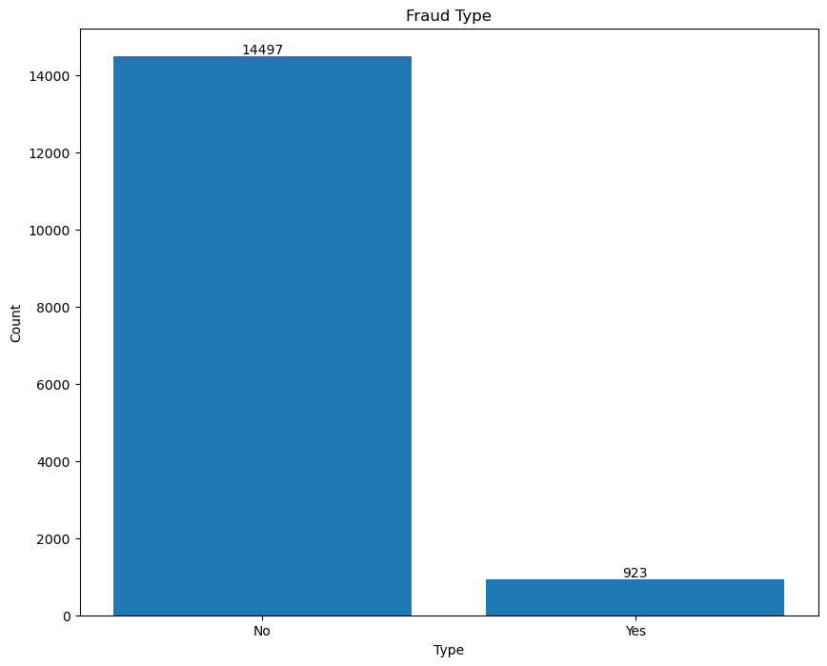
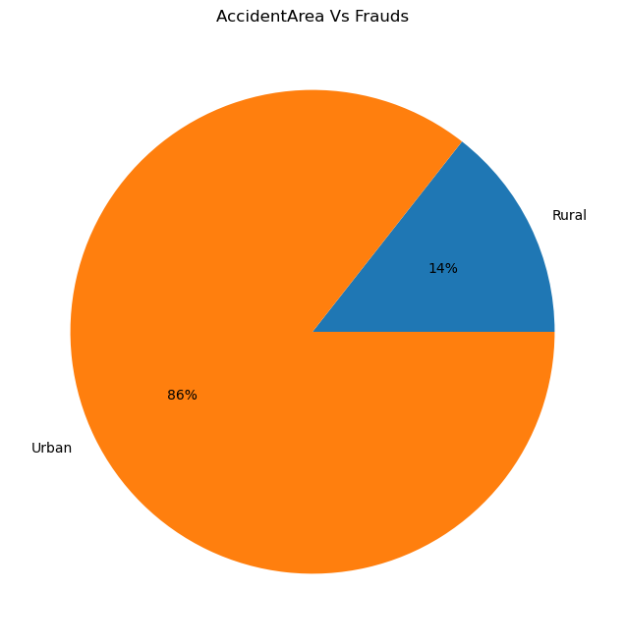
EDA (Exploratory Data Analysis)

Slide 8
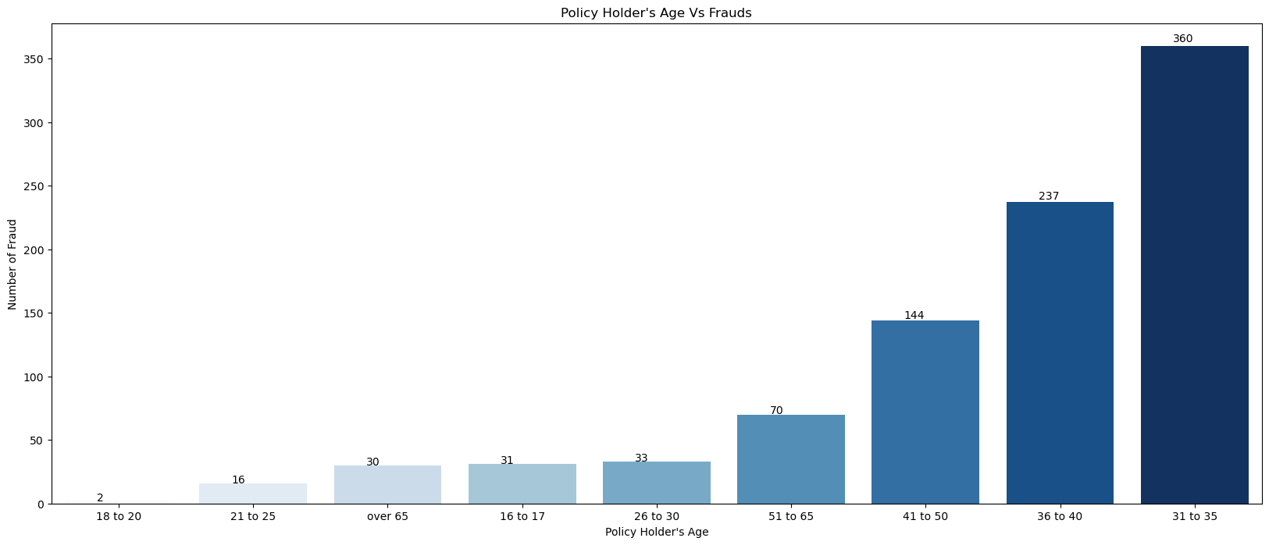
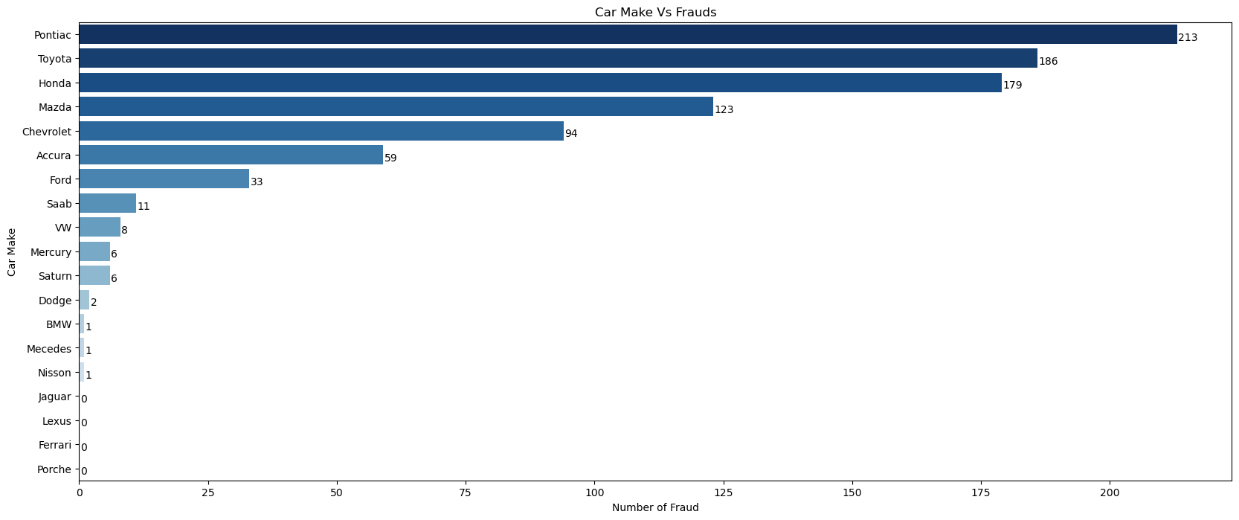
EDA (Cont.)

Slide 9
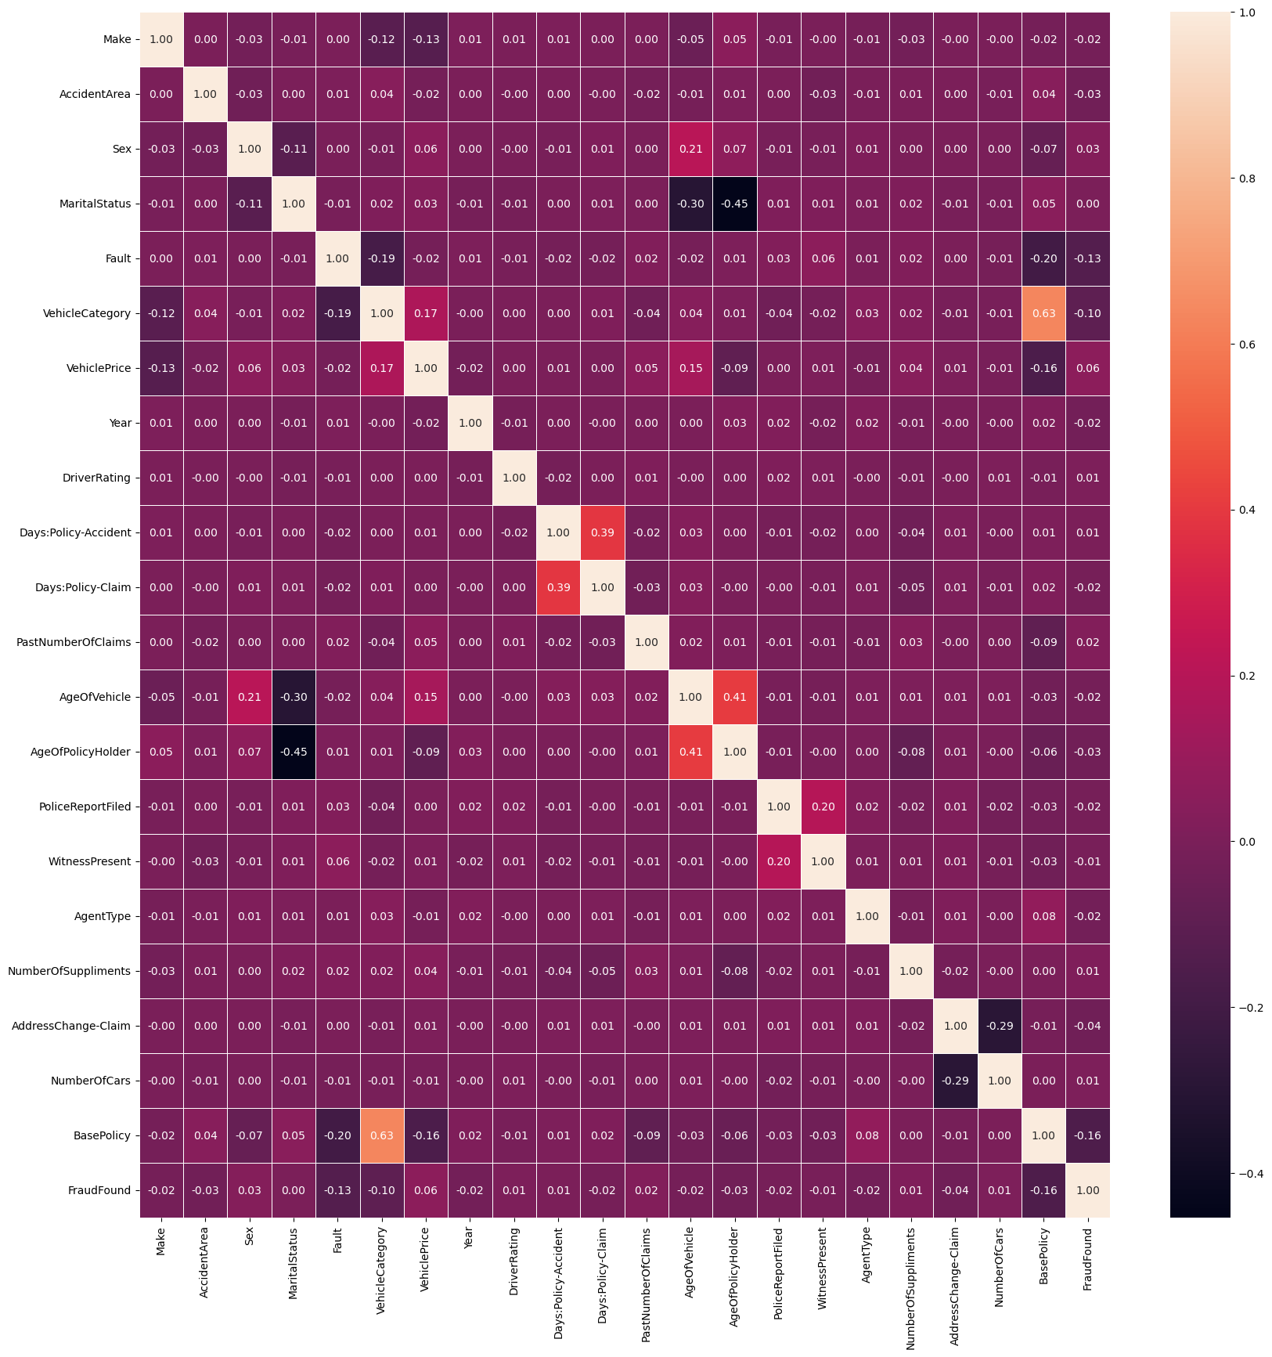
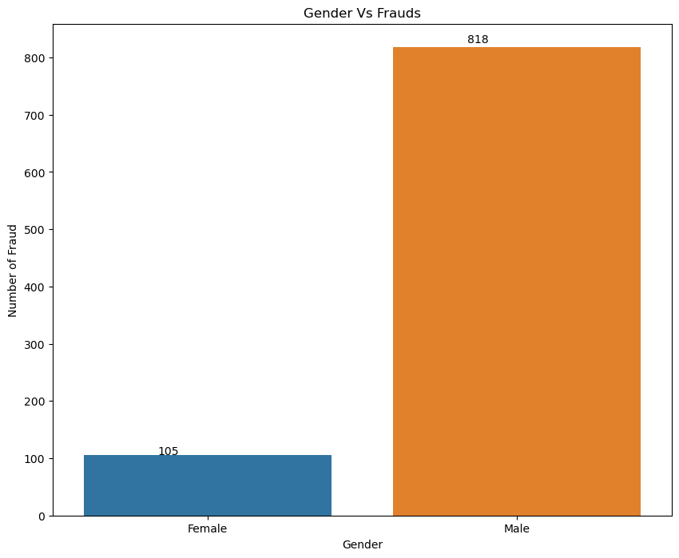
EDA (Cont.)

Slide 10
Model Development
To determine if the claim is false or not, we used a variety of supervised machine learning methods, such as:
Random Forest: In essence, Random Forest is used for both classification and regression issues. It is an ensemble classification method and a supervised machine learning classifier. The more trees there are, the more precise the outcome would be. The RF machine learning method is simple, easy to use, and capable of achieving outstanding outcomes in most cases without the need for hyper tuning.
Logistic Regression: It is a condensed version of "linear regression," a potent tool for visualizing data. The likelihood of an illness or other health concern because of a plausible cause is ascertained using logistic regression. The link between independent factors (X), also known as exposures or predictors, and a binary dependent (target) variable (Y), also known as the outcome or response variable, is examined using both basic and multivariate logistic regressions.

Slide 11
Model Development (Cont.)
K-Nearest Neighbor: K-Nearest Neighbor is one of the most straightforward machine learning algorithms, based on the supervised learning approach (KNN). The model is saved, and when a new data point is given, the model searches for similarities between the data points. K-nearest neighbors are identified by calculating the distance between each data point with respect to the new data point, and based on the similarity, it produces the output. This method is also referred to as lazy learning.
Decision Trees: The decision tree approach is also included in the supervised learning category. Regression and classification problems can be solved with DT. However, it is used in this work to overcome categorization problems. DT breaks down the input into ever-smaller bits in an attempt to solve the problem, which results in the prediction of a target value (diagnosis). A decision tree (DT) consists of decision nodes and leaf nodes, each of which is linked to a class label and traits that are shown on the interior node of the tree.

Slide 12

Model Evaluation
The Receiver Operating Characteristic suggests that while the model is accurate in terms of correctly predicting the majority class, it’s not doing well in predicting the minority class. The F1 Score and Recall are both measures of a model’s performance in terms of handling both classes in a balanced way. A low score indicates that the model is not predicting the minority class correctly.
This could be due to an imbalance in the classes in the data. We may consider using techniques like Up sampling the minority class or Down sampling the majority class to handle the class imbalance.
Up sampling is a technique used to address class imbalance by increasing the number of minority class samples.
Down sampling is a technique used to address class imbalance by decreasing the number of majority class samples.

Slide 13
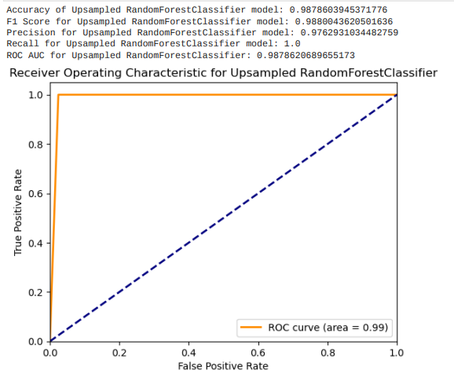
Model Evaluation (Cont.)
After performing sampling, the Up sampled Random Forest Classifier model has an accuracy of 98.66%. The F1 Score is 0.9868, Precision is 0.9739, and Recall is 1.0. The ROC AUC score is 0.9866.
These scores suggest that the model’s performance is excellent. The accuracy, F1 Score, Precision, Recall, and ROC AUC are all very high, indicating that the model’s ability to correctly and classify instances is much better than random chance.

Slide 14
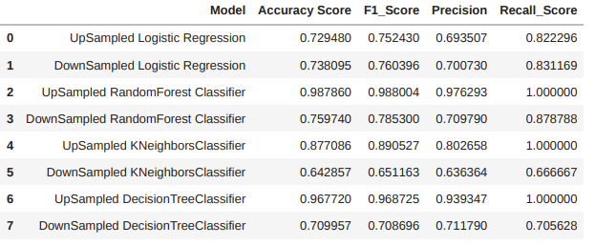
Results
From the table we can say that Up sampled Random Forest Classifier model is suitable model with high accuracy in all evaluation metrics.

Slide 15
Conclusion
As the different countries around the world evolve into a more economical based one, stimulating their economy is the goal. To fight these fraudsters and money launderers was quite a complex task before the era of machine learning but thanks to machine learning and AI we can fight these kinds of attacks. The proposed solution can be used in insurance companies to find out if a certain insurance claim made is a fraud or not. The model was designed after testing multiple algorithms to come up with the best model that will detect if a claim is fraudulent or not. This is aimed at the insurance companies as a pitch to come up with a more tailored model for their liking to their own systems. The model should be simple enough to calculate big datasets, yet complex enough to have a decent successful percentile.

Slide 16
Future Developments
Advanced Sampling Techniques: While we used up sampling to handle class imbalance, there are other advanced techniques like SMOTE or ADASYN that you could explore.
Feature Engineering: Creating new features based on existing ones can often improve model performance. For example, creating interaction features, binning variables, or creating polynomial features.
Ensemble Methods: Combining predictions from multiple models can often yield better results than any individual model. Techniques like bagging, boosting, or stacking could be used.
Deep Learning Models: If you have a large amount of data, deep learning models can sometimes outperform traditional machine learning models.
Repository Link: https://github.com/Hanumanthareddy12/Automated-Vehicle-Insurance-Fraud-Detection

Slide 17
References
[1] Amr, Tarek. Hands-On Machine Learning with scikit-learn and Scientific Python Toolkits: A practical guide to implementing supervised and unsupervised machine learning algorithms in Python. Packt Publishing Ltd, 2020.
[2] Kini, R. Chelluru, K. Naik, D. Naik, S. Aswale and P. Shetgaonkar, "Automobile Insurance Fraud Detection: An Overview," 2022 3rd International Conference on Intelligent Engineering and Management(ICIEM),London,UnitedKingdom,2022,pp.7-12,doi: 10.1109/ICIEM54221.2022.9853043.
[3] Amr, Tarek. Hands-On Machine Learning with scikit-learn and Scientific Python Toolkits: A practical guide to implementing supervised and unsupervised machine learning algorithms in Python. Packt Publishing Ltd, 2020.
[4] PACKT, P. (Producer), & . (2018). Hands-on Supervised Machine Learning with Python. [Video/DVD] PACKT Publishing. https://video.alexanderstreet.com/watch/hands-on-supervised-machine-learning-with-python
[5] Rashmi. (2022). Vehicle Insurance Fraud Detection. Kaggle. Retrieved from Kaggle

Slide 18


